Slide 1


Deforestation(Fire Classification)
Name: Sai Nikhileswar Gurram
Student ID:STU680c7675c324b1745647221
AICTE ID: INTERNSHIP_1748923002683e727a876ea

Slide 2

Learning Objectives
Understand the role of MODIS satellite data in detecting thermal anomalies.
Learn to preprocess and analyze geospatial fire detection datasets.
Develop a machine learning model to classify types of fire events.
Explore key MODIS features used in thermal anomaly detection.
Evaluate model performance using classification metrics.
Visualize and interpret fire incident patterns across India (2021–2023).
GOAL
Source :
www.freepik.com/

Slide 3
Tools and Technology used
Tools:
VS Code
Jupyter Notebook
Technology:
Python
Libraries:
Pandas
NumPy
Shapely
Pyproj
Matplotlib
Seaborn
Folium
Scikit-learn
XGBoost
LightGBM

Slide 4
Methodology
1. Data Collection
Extracted MODIS fire detection data (India, 2021–2023) from NASA FIRMS.
Included features like latitude, longitude, brightness, scan, track, FRP (Fire Radiative Power), satellite, and confidence.
2. Data Preprocessing
Handled missing values and filtered out irrelevant or low-confidence detections.
Encoded categorical features (e.g., satellite type, fire type).
Normalized or scaled numerical features (e.g., brightness, FRP).
3. Exploratory Data Analysis (EDA)
Visualized fire occurrences by type, region, and time.
Mapped hotspots and inspected seasonal or geographic patterns.
Data Source :
https://www.earthdata.nasa.gov/data/tools/firms

Slide 5
Methodology
4. Feature Engineering
Created derived features such as day/night flag, brightness difference, region clusters, etc.
Used geospatial techniques to group locations (optional: state-level tagging).
5. Model Development
Trained multiple classification models (e.g., Random Forest, XGBoost, LightGBM).
Tuned hyperparameters using GridSearchCV or cross-validation techniques.
6. Model Evaluation
Evaluated models using Accuracy, Precision, Recall, F1-Score, and Confusion Matrix.
Compared performance across models to select the best-performing one.
7. Visualization & Insights
Plotted fire type predictions on India’s map using GeoPandas/Folium.
Highlighted patterns in vegetation fires vs. volcanic/offshore/static sources.
8. Deployment (Optional)
Exported the best model using joblib or pickle.
Developed a simple interface using Streamlit for real-time predictions.

Slide 6
Problem Statement:
India experiences a wide range of fire events annually — including Vegetation Fires, Other Static Land Sources, and Offshore Fires — which pose serious risks to ecosystems, air quality, and human safety. While NASA’s MODIS satellites provide reliable, near real-time thermal anomaly data, accurately classifying the type of fire source remains a challenge due to overlapping characteristics and environmental variability. This project aims to develop a machine learning-based classification model that can effectively predict the source of fire using MODIS fire detection data from 2021 to 2023 in India, thereby supporting timely disaster response, environmental monitoring, and strategic resource allocation.

Slide 7
Solution:
To address the challenge of identifying fire sources, we propose a machine learning-based classification system that analyzes MODIS fire detection data from 2021 to 2023 in India. The system uses satellite-derived geospatial and thermal features — such as brightness, FRP, coordinates, and satellite type — to classify fire events into categories like vegetation fires, volcanic activity, static land sources, and offshore fires. By leveraging models like Random Forest, XGBoost, and LightGBM, and evaluating them with performance metrics, the solution enables accurate, automated fire type prediction. This helps in enhancing real-time monitoring, targeted response strategies, and informed environmental decision-making.
Github Link:
https://github.com/SaiNikhileswar/Shell-Virtual-Insternship-Final.git

Slide 8
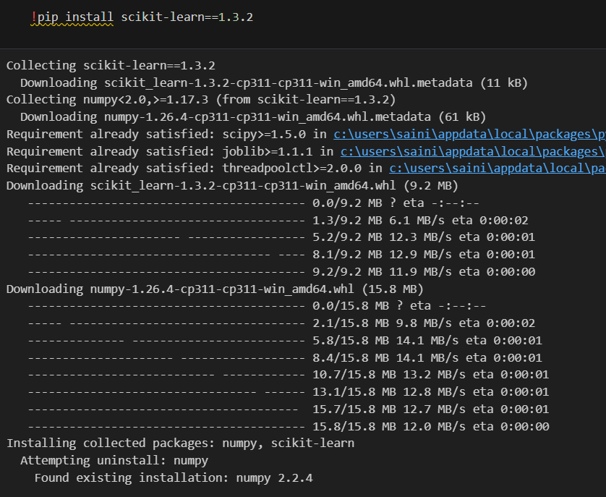
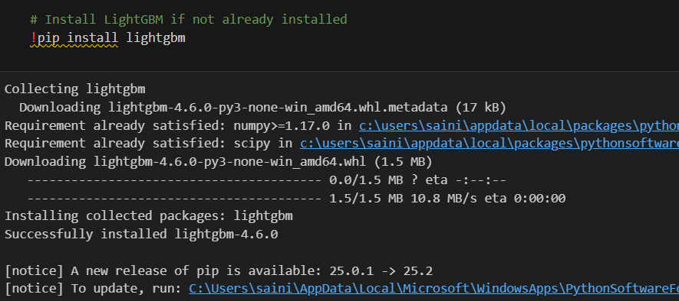
Screenshot of Output:

Slide 9
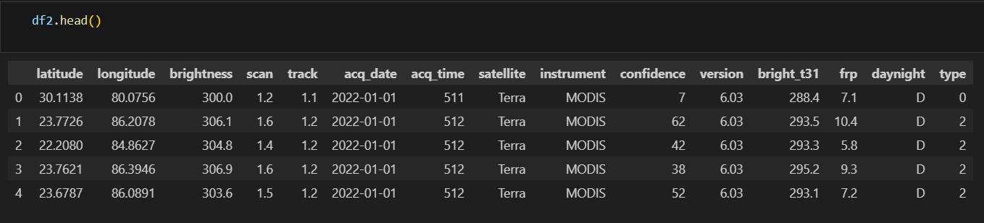
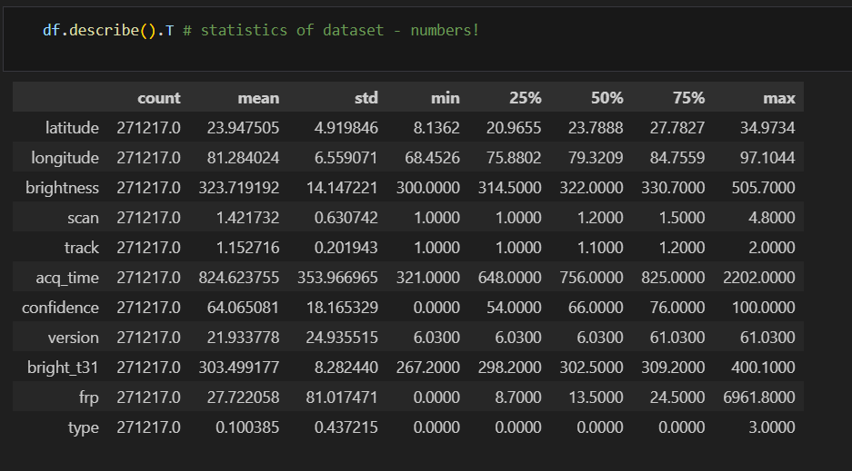
Screenshot of Output:

Slide 10
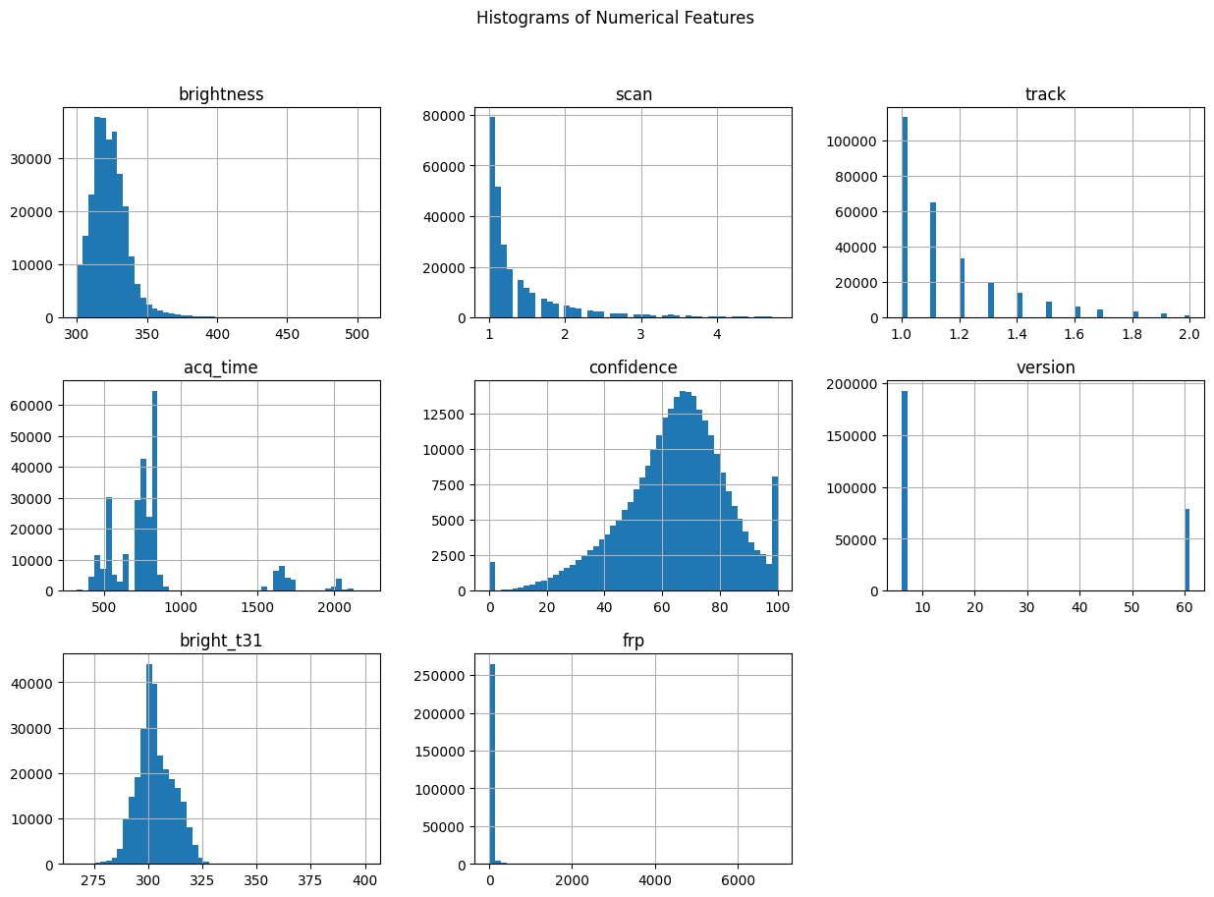
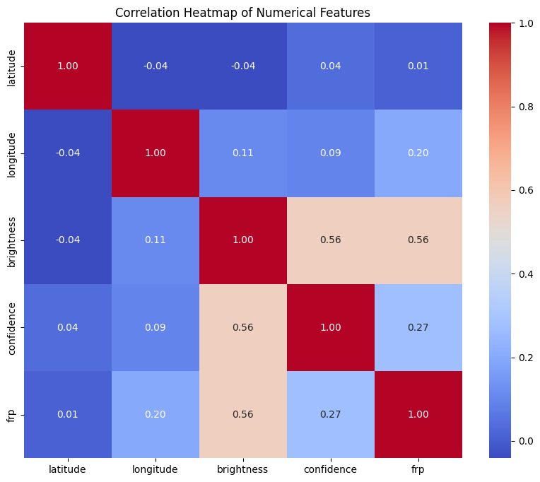
Screenshot of Output:

Slide 11
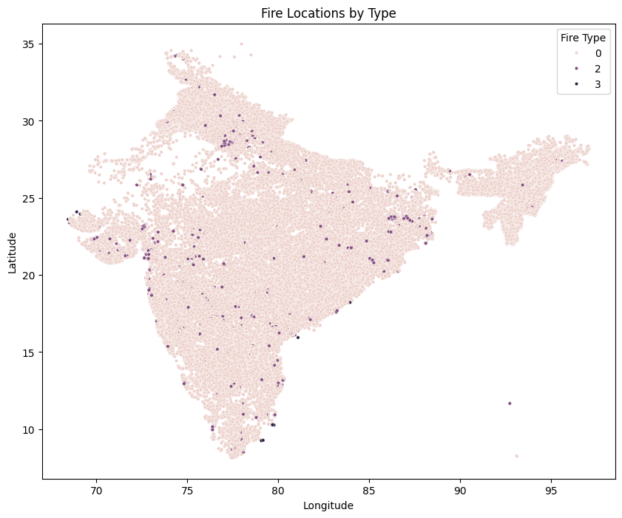
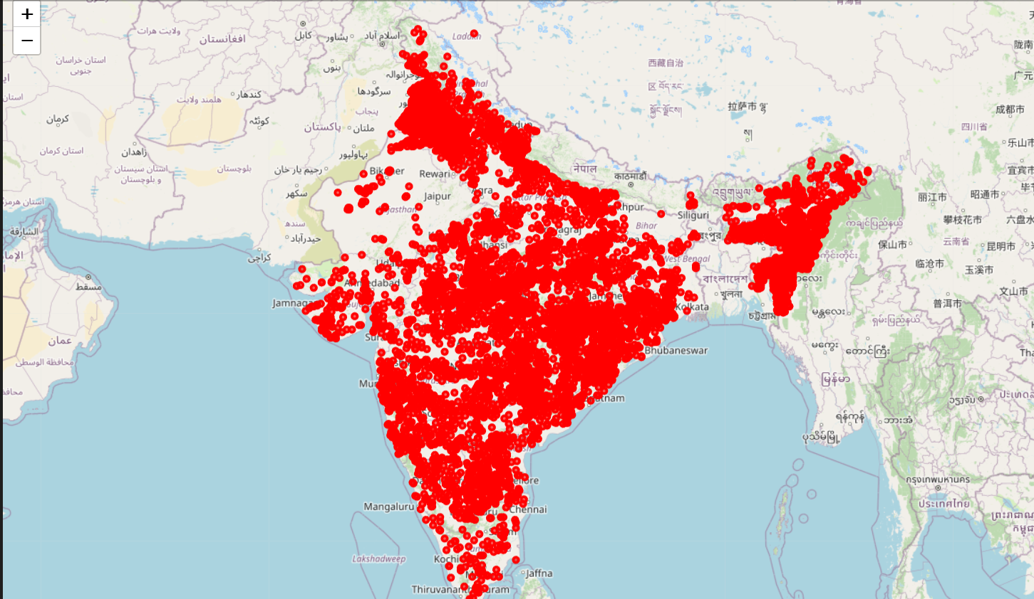
Screenshot of Output:

Slide 12
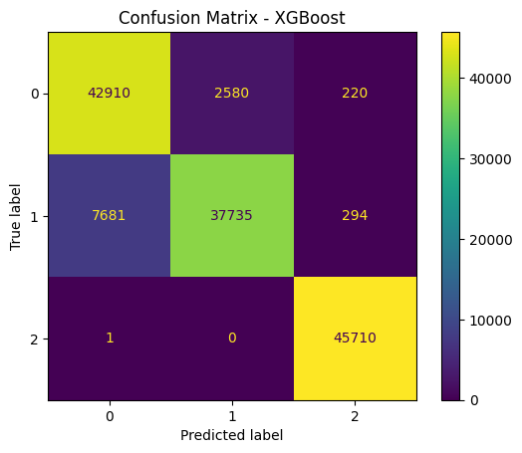
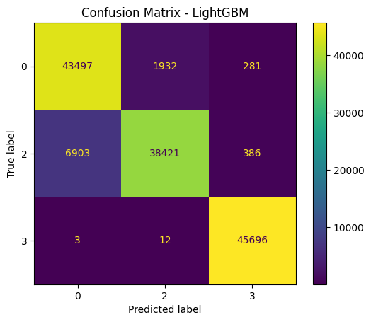
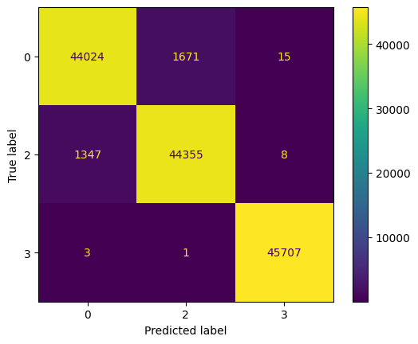
Screenshot of Output:
RandomForest

Slide 13
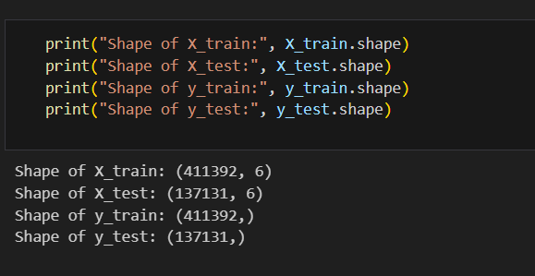
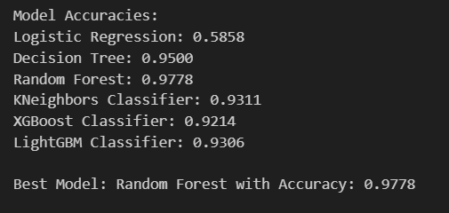
Screenshot of Output:

Slide 14
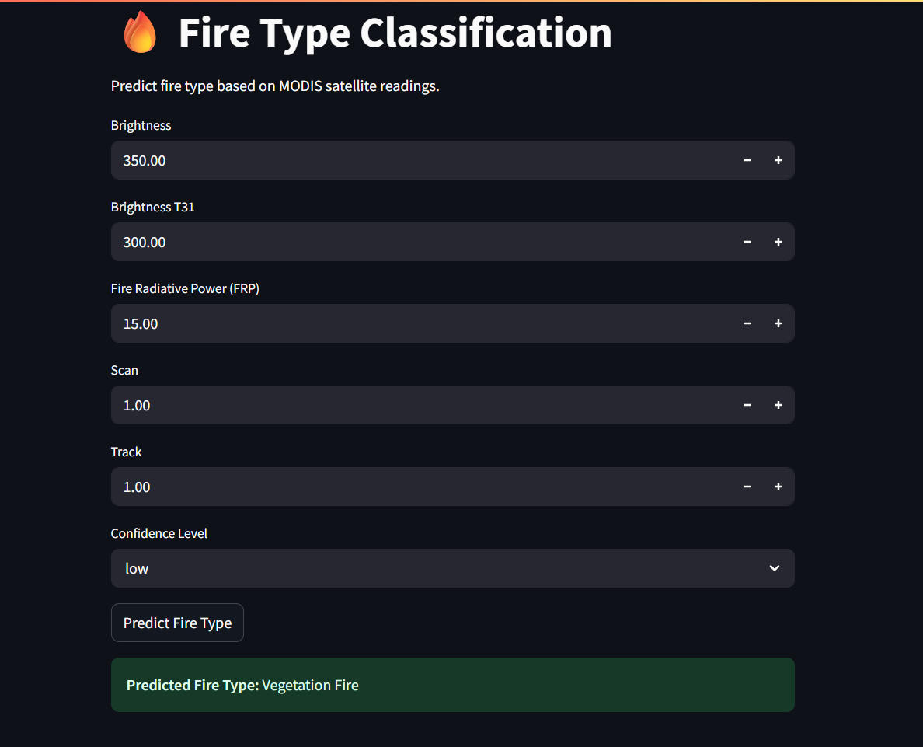
Screenshot of Output:

Slide 15
Conclusion:
The Random Forest model outperformed all others with the highest accuracy of 97.78%, making it the most effective for classifying fire types using MODIS data. Decision Tree and KNeighbors Classifier also demonstrated strong performance with accuracies of 95% and 93.11% respectively. LightGBM and XGBoost classifiers followed closely, achieving 92.14% and 93.06% accuracy, indicating their suitability for scalable and efficient classification tasks. In contrast, Logistic Regression showed the lowest accuracy at 58.58%, suggesting it is not well-suited for handling the complexity of this multi-class problem. Overall, Random Forest emerged as the most reliable model for accurate fire type prediction.

